Slide 1
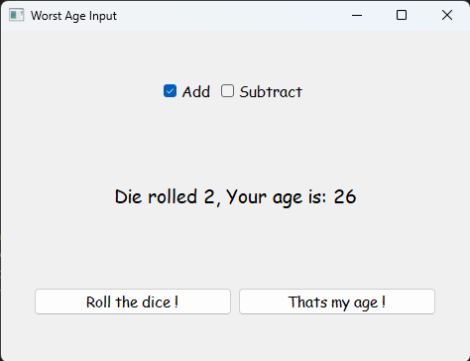
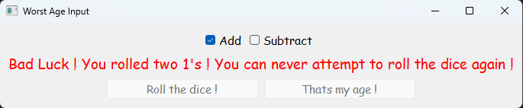
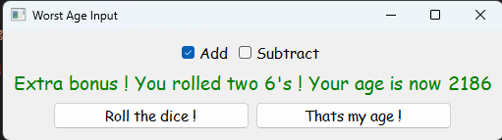
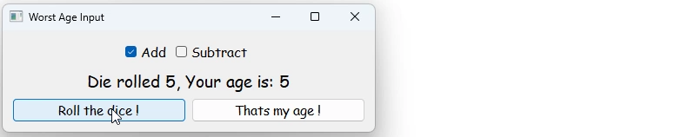
Notes:
Worst Age Input
Why should you input your age normally when you can have fun doing it !
Gamify your user experience of inputting a single (1) number into a computer system
Don’t let an input formular sever you from the only important thing in the whole world – gambling
Features the most famous font type – Comic Sans. Which just shows the full commitment of delivering truly next-gen look.
Uses a revolutionary dice mechanic which allows you to add or subtract random numbers from your age. With a new groundbreaking control scheme, YOU can write actual symbols into computer with only mouse. No more lousy and expensive keyboards required. Also contains amusing special bonuses like MAX WIN (Throw two 6’s in a row) which adds number 2000 to your age for the biggest profits. To secure constant high stakes gameplay there is also INSTANT FAIL (Throw two 1’s in a row) which locks you from the system. GET IT TWISTED !
How to use:
Select if you want to add or subtract numbers from your age
Roll the dice ! Rolled number will be added or subtracted from your age
Hope for the best
If you are happy with your inputted age, click “That’s my age !”
Company, for which the formular was made, is deeply age-phobic, therefore only accepted age is in range 18-99 years. If you were lucky and scored high score with our special bonuses, then bad luck for you because you need to lower your age to acceptable range before you continue.

